Slide 1
Running on autopilot or taking the wheel?
The role of automaticity and self-control on attitudes towards organisational diversity initiatives
Zachary W Petzel¹, Lynn Farrell², Ioana M Latu³
¹Newcastle University, ²National College of Ireland, ³Queen’s University Belfast

Slide 2
Equality initiatives
Progress towards parity is slow despite equality initiatives
Closing STEM gender gap may take over a century
Problems current initiatives may face:
  Promote ineffective motivations
  Elicit backlash and threat
Danbold and Huo (2017); Dover et al. (2016); Holman et al. (2018)

Slide 3
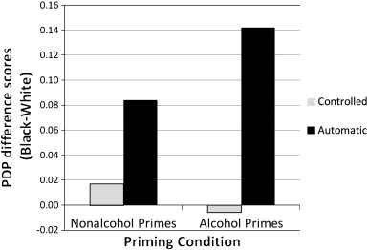
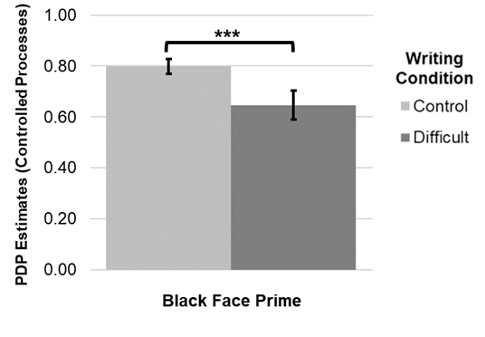
Automaticity versus self-control
Automatic processes
  Relatively unconscious
  Spreading activation due to prime
  Quick responses (e.g., heuristics)
Controlled processes
  Requires conscious effort
  Verify automatic processes
  Longer reaction times
Jacoby (1991); Payne (2001; 2006); Petzel et al. (2022); Stepanova et al. (2012)

Slide 4
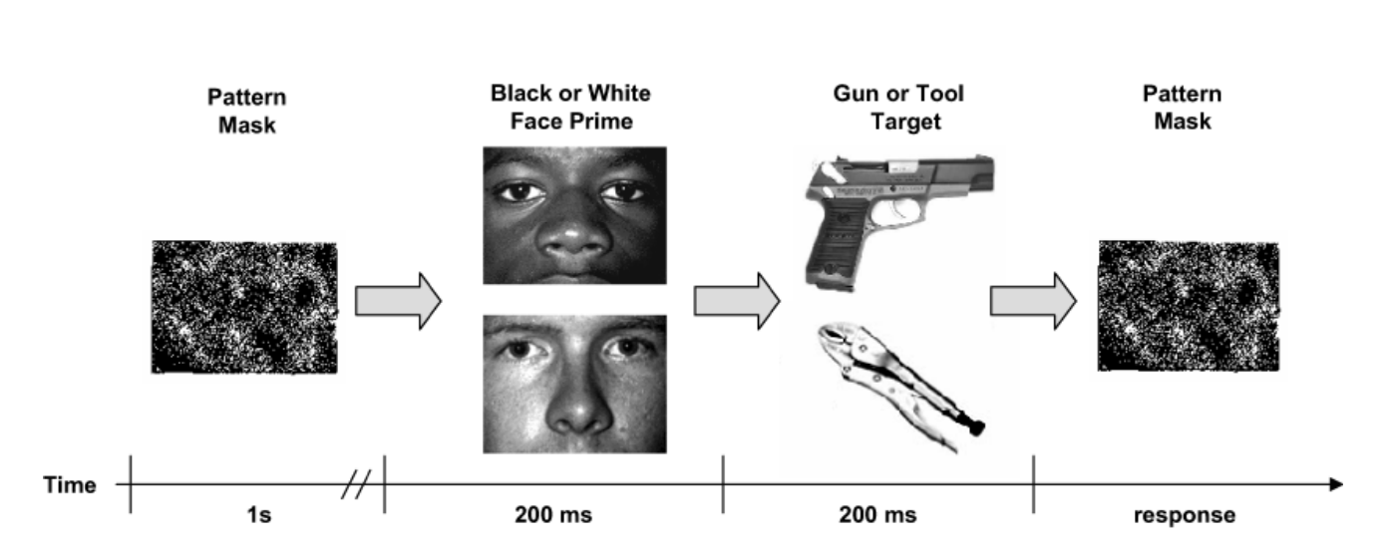
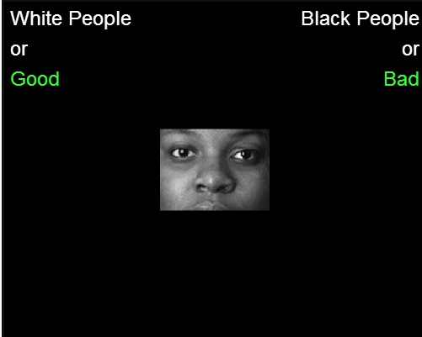
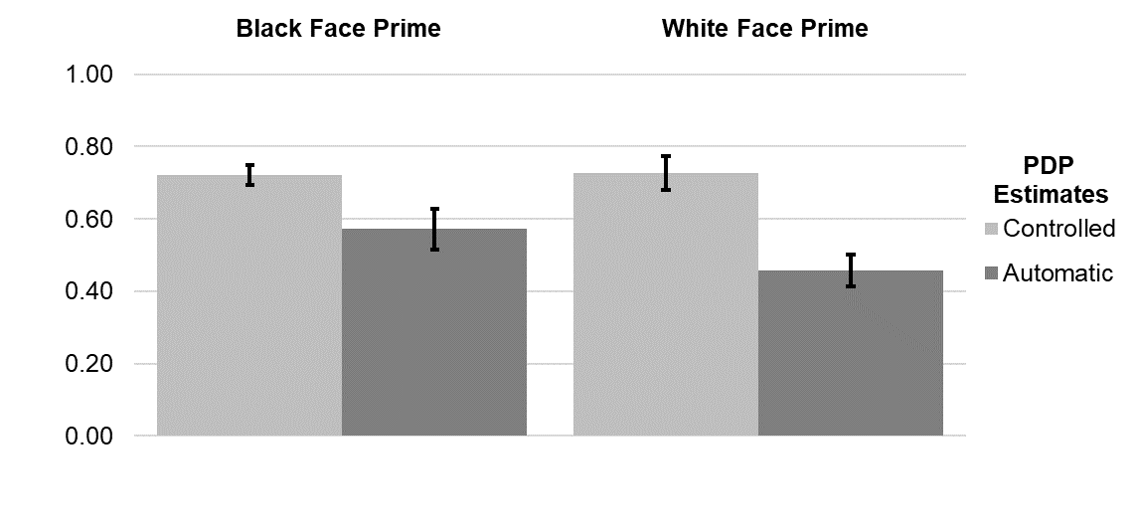
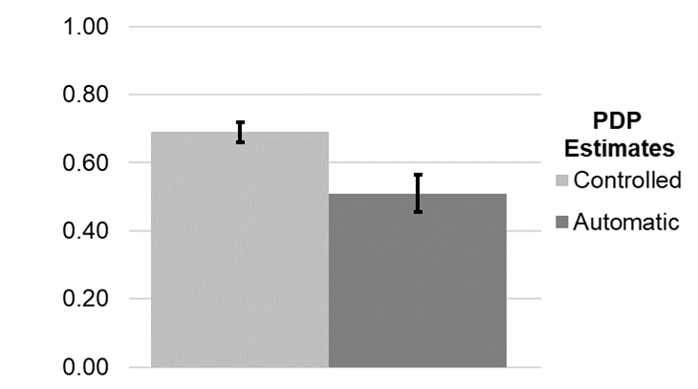
Automaticity versus self-control
Amodio et al. (2004); Petzel et al. (2022); Stewart et al. (2009)

Slide 5
Automaticity versus self-control
Responding appropriately
  Correct responses to congruent pairings
  Control + Strength of automatic bias if control fails
    C + A(1 – C)
Responding inappropriately
  Incorrect responses to incongruent pairings
  Strength of automatic bias if control fails
    A(1 – C)
Jacoby (1991); Payne (2001; 2008); Stepanova et al. (2012); Stewart et al. (2009)

Slide 6
Automaticity versus self-control
Controlled processes
  Probability of congruent (correct) minus incongruent (error) trials
    C = P(congruent|correct) – P(incongruent|error)
Automatic processes
  Probably of incongruent trials (error) divided by inverse of C
    A = P(incongruent|error)/(1 – C)
Jacoby (1991); Payne (2001; 2008); Stepanova et al. (2012); Stewart et al. (2009)

Slide 7
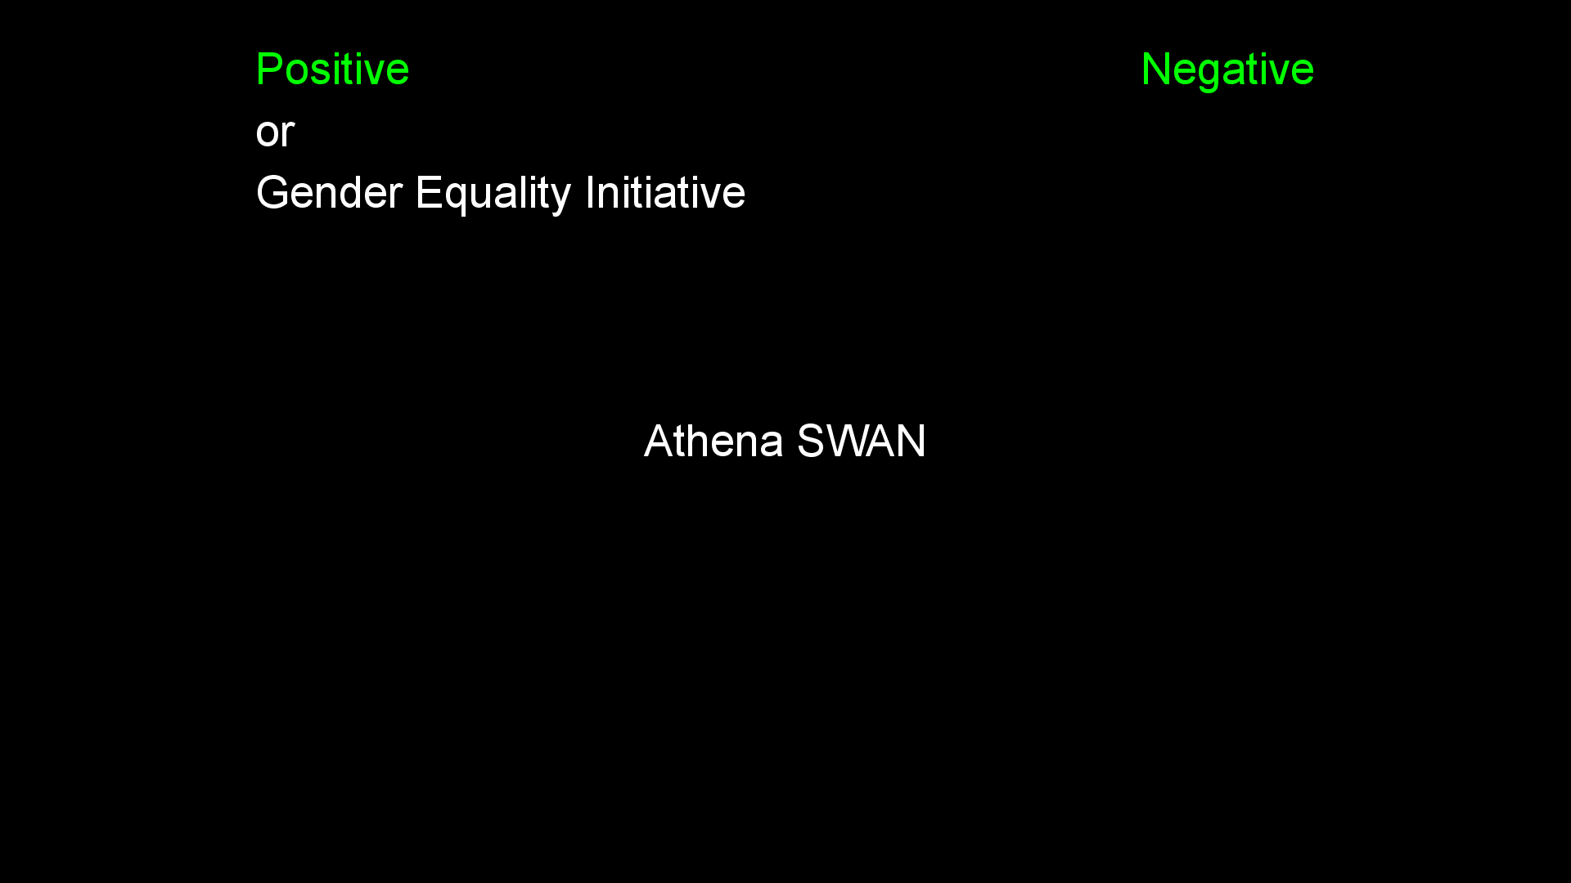
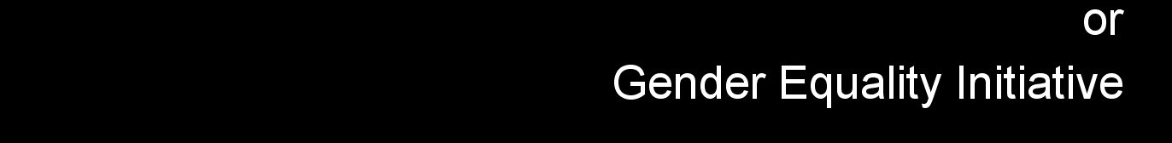
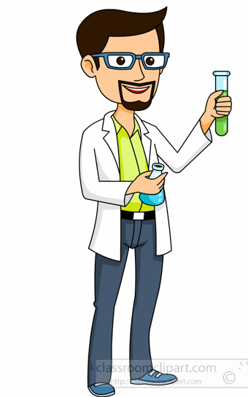
Automaticity versus self-control
Controlled estimate = .80
100% correct - 20% error
Automatic estimate = 1.00
20% error/(1 - .80)
Due to strong automatic tendencies

Slide 8
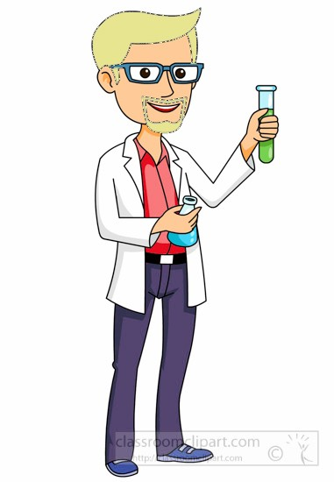
Automaticity versus self-control
Controlled estimate = .65
75% correct - 10% error
Automatic estimate = .29
10% error/(1 - .65)

Slide 9
The role of motivation
Equality interventions seen as “box-ticking” exercise
  Externally motivated (e.g., fear of consequences)
  May elicit backlash against intervention targets
  Behavior change requires use of self-control
Promoting internal motivations to participate
  Employees feel more valued by organization
  Leads to knowledge sharing and self-efficacy
  Actions become more spontaneous (i.e., automaticity)
Ely & Thomas (2001); Legault et al. (2011), Ovseiko et al. (2017), Ryan & Deci (2017); Tzanakou et al. (2019)

Slide 10
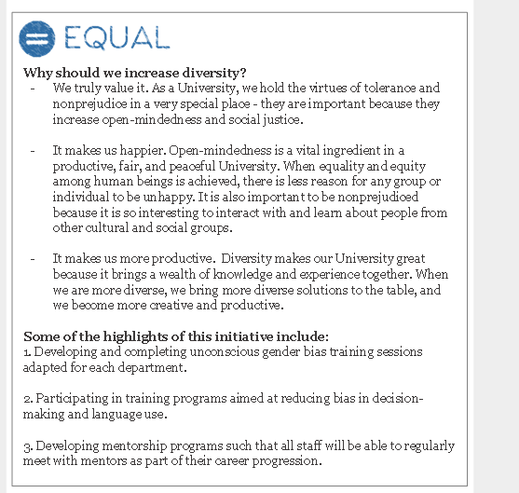

Experiment 1 (N = 56)
Manipulated motivation to participate in initiatives
  External
  Internal
Recruited STEM staff, postdocs, and PhD students
  3 UK universities (online)
  51.8% women, 48.2% men

Slide 11
Experiment 1 (N = 56)

Slide 12
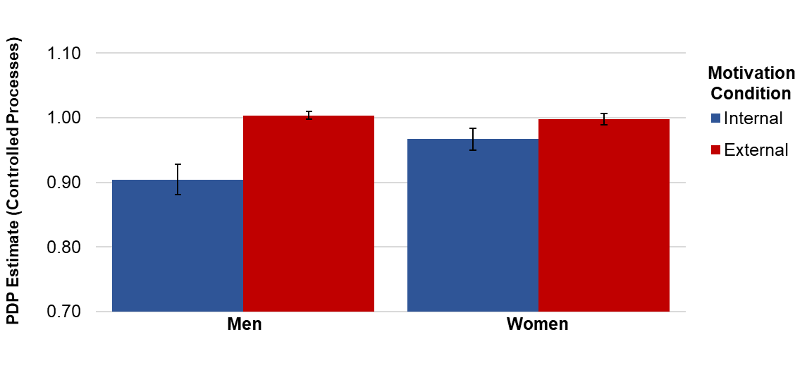
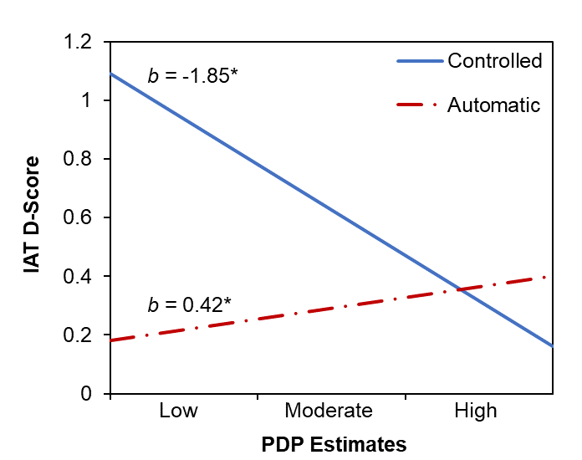
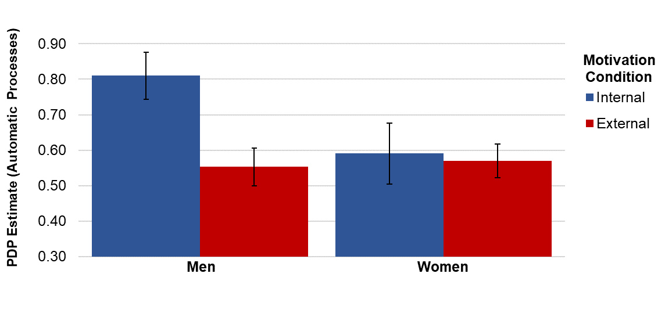
Experiment 1 (N = 56)
F(1,52) = 4.21, p = .045, η_{p}² = .075
F(1,52) = 3.21, p = .079, η_{p}² = .058

Slide 13
Experiment 1 (N = 56)
Promoting external motives
  Increased cognitive control among men
  Decreased positive bias towards interventions
Promoting internal motives
  Increased automaticity among men
  Increased positive bias towards interventions
No significant differences in processes among women

Slide 14
Sources of threat
Loss of career opportunities
  Concerns of reverse-sexism
  Hiring and promoting men in STEM may decrease
Biological sex differences
  Longstanding beliefs of male dominance in STEM
  Influence of inaccurate gender stereotypes
Cundiff et al. (2018); Norton and Sommers (2011); Wilkins and Kaiser (2014)

Slide 15
Sources of threat
Loss of career opportunities (realistic threat)
  Concerns of reverse-sexism
  Hiring and promoting men in STEM may decrease
Biological sex differences (symbolic threat)
  Longstanding beliefs of male dominance in STEM
  Influence of inaccurate gender stereotypes
Cundiff et al. (2018); Norton and Sommers (2011); Wilkins and Kaiser (2014)

Slide 16
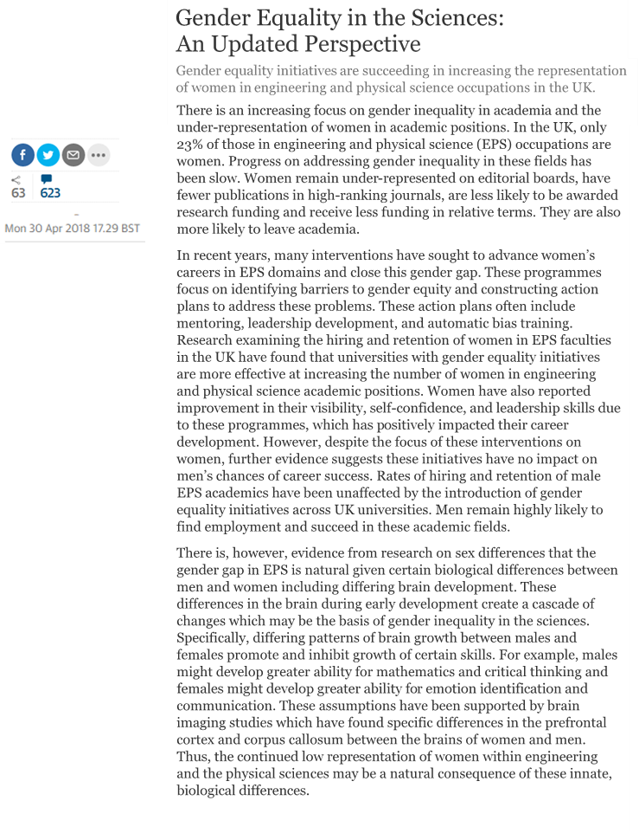
Experiment 2 (N = 95)
Manipulated sources of threat via ostensible articles
  Career opportunities
  Biological justifications
Recruited male STEM staff, postdocs, and PhD students
  1 UK university (lab)
  3 UK universities (online)

Slide 17
Experiment 2 (N = 95)
Biological sex differences
“…differing patterns of brain growth between males and females promote… certain skills.”
“These assumptions have not been supported by brain imaging studies.”
Career opportunities
“Men are now somewhat less likely to find employment in these fields.”
“Men remain highly likely to find employment and succeed in these academic fields.”

Slide 18
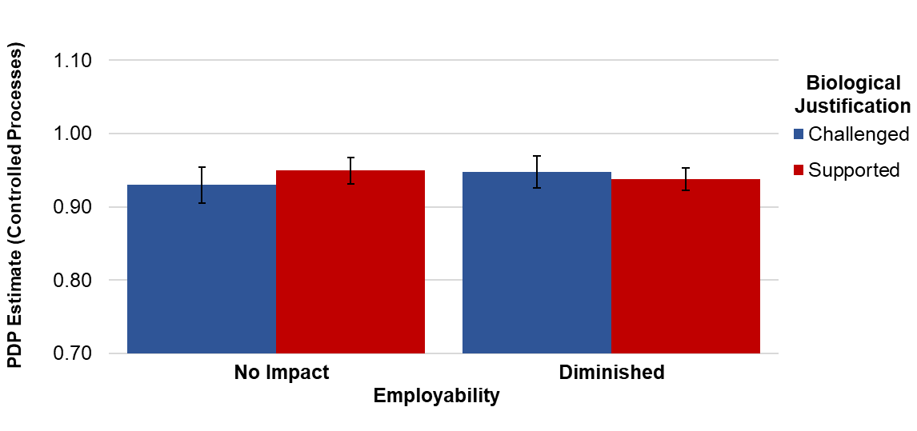
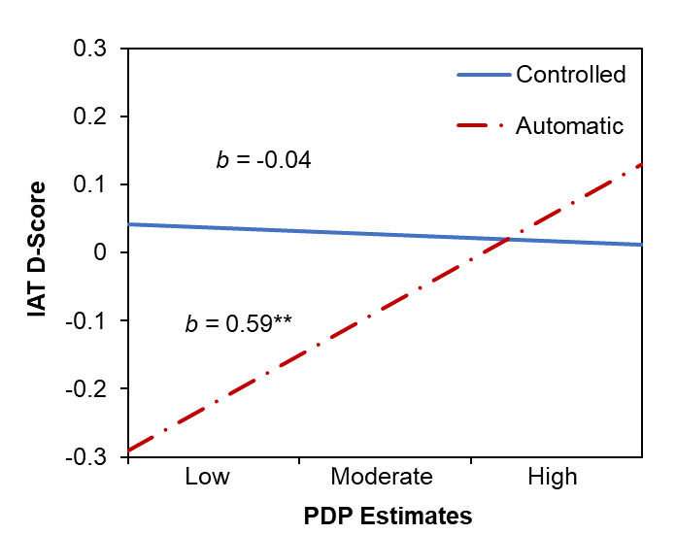
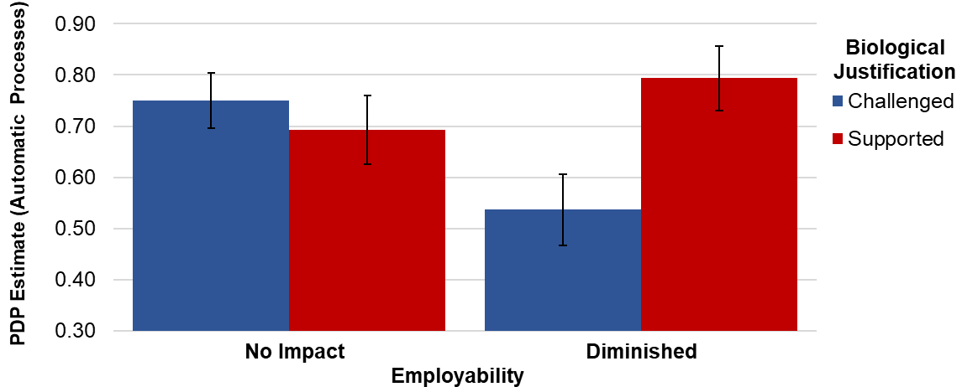
Experiment 2 (N = 95)
F(1,91) = 0.51, p = .477, η_{p}² = .006
F(1,91) = 6.05, p = .016, η_{p}² = .062

Slide 19
Experiment 2 (N = 95)
Threat may not affect self-control of implicit biases
Combination of threats may reduce automaticity
  Realistic and symbolic threats
  Promote negative bias towards interventions
Impact on women’s biases not tested
  May worry success due to initiative, not merit (Ovseiko et al., 2017)
  Reducing men’s opportunities may promote negative bias

Slide 20
Implications
Importance of automaticity and self-control
  Controlled processes = negative bias
  Automatic processes = positive bias
Considerations when implementing interventions
  Framing the initiative (i.e., motivations)
  Sex differences in underlying processes
  How initiatives may threaten participants

Slide 21
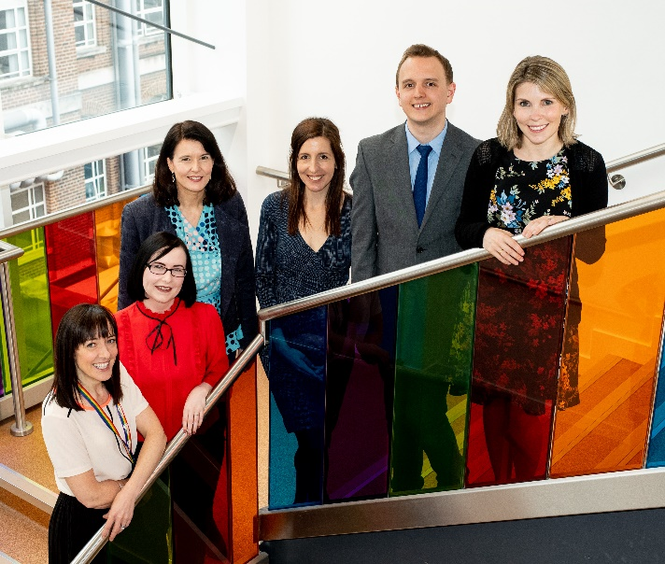


Thank you!
Amodio, D. M., Harmon-Jones, E., Devine, P. G., Curtin, J. J., Hartley, S. L., & Covert, A. E. (2004). Neural signals for the detection of unintentional race bias. Psychological Science, 15(2), 88-93.
Cundiff, J. L., Ryuk, S., & Cech, K. (2018). Identity-safe or threatening? Perceptions of women-targeted diversity initiatives. Group Processes & Intergroup Relations, 21(5), 745-766.
Danbold, F., & Huo, Y. J. (2017). Men's defense of their prototypicality undermines the success of women in STEM initiatives. Journal of Experimental Social Psychology, 72, 57-66.
Dover, T. L., Major, B., & Kaiser, C. R. (2016). Members of high-status groups are threatened by pro-diversity organizational messages. Journal of Experimental Social Psychology, 62, 58-67.
Ely, R. J., & Thomas, D. A. (2001). Cultural diversity at work: The effects of diversity perspectives on work group processes and outcomes. Administrative Science Quarterly, 46(2), 229-273.
Holman, L., Stuart-Fox, D., & Hauser, C. E. (2018). The gender gap in science: How long until women are equally represented?. PLoS Biology, 16(4), e2004956.
Jacoby, Larry L. "A process dissociation framework: Separating automatic from intentional uses of memory." Journal of Memory and Language 30.5 (1991): 513-541.
Legault, L., Gutsell, J. N., & Inzlicht, M. (2011). Ironic effects of antiprejudice messages: How motivational interventions can reduce (but also increase) prejudice. Psychological Science, 22(12), 1472-1477.
Norton, M. I., & Sommers, S. R. (2011). Whites see racism as a zero-sum game that they are now losing. Perspectives on Psychological Science, 6(3), 215-218.
Ovseiko, P. V., Chapple, A., Edmunds, L. D., & Ziebland, S. (2017). Advancing gender equality through the Athena SWAN Charter for Women in Science: an exploratory study of women’s and men’s perceptions. Health Research Policy and Systems, 15(1), 1-13.
Payne, B. K. (2001). Prejudice and perception: The role of automatic and controlled processes in misperceiving a weapon. Journal of Personality and Social Psychology, 81(2), 181–192.
Payne, B. K. (2006). Weapon bias: Split-second decisions and unintended stereotyping. Current Directions in Psychological Science, 15(6), 287-291.
Petzel, Z. W., Noel, J. G., & Casad, B. J. (2022). Discrimination Without Intoxication: The Role of Controlled Processes in the Promotion of Racial Bias After Viewing Alcohol-Related Cues. Social Cognition, 40(5), 459-484.
Ryan, R. M. (2017). Self-Determination Theory: Basic Psychological Needs in Motivation, Development, and Wellness. New York., NY: Guilford Press.
Stepanova, E. V., Bartholow, B. D., Saults, J. S., & Friedman, R. S. (2012). Alcohol-related cues promote automatic racial bias. Journal of Experimental Social Psychology, 48(4), 905-911.
Stewart, B. D., Von Hippel, W., & Radvansky, G. A. (2009). Age, race, and implicit prejudice: Using process dissociation to separate the underlying components. Psychological Science, 20(2), 164-168.
Tzanakou, C., & Pearce, R. (2019). Moderate feminism within or against the neoliberal university? The example of Athena SWAN. Gender, Work & Organization, 26(8), 1191-1211.
Wilkins, C. L., & Kaiser, C. R. (2014). Racial progress as threat to the status hierarchy: Implications for perceptions of anti-White bias. Psychological Science, 25(2), 439-446.
https://socialneuroscience.co.uk/

