Slide 1
It's not what you say, it's how you say it:
How promoting meritocracy and internal motivations promote support for gender equality initiatives among STEM academics
Dr Zachary W Petzel

Slide 2
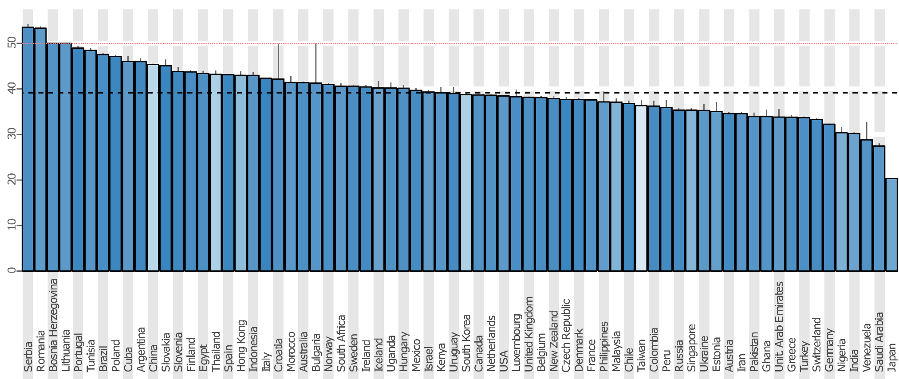

Roadblocks
Progress towards parity is slow despite equality initiatives
Closing STEM gender gap may take over a century
(Holman et al., 2018)

Slide 3
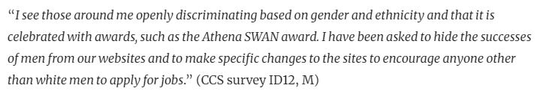
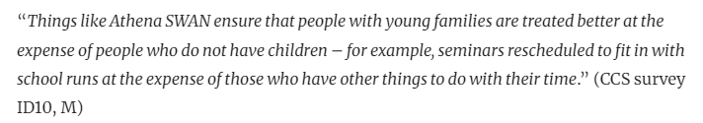
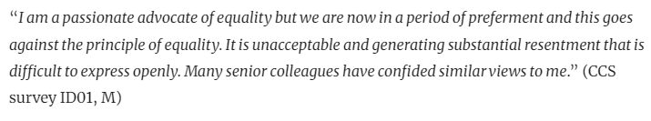
Roadblocks
Equality initiatives often met with negative attitudes
Most prominent among men who make up majority of STEM
(Ovseiko et al. 2017)

Slide 4
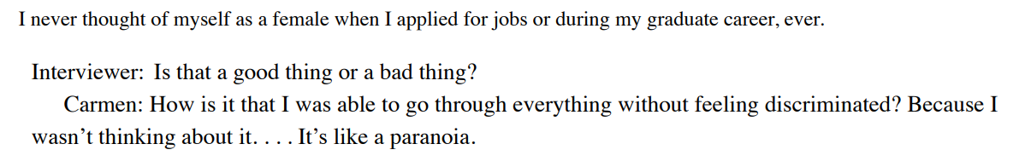
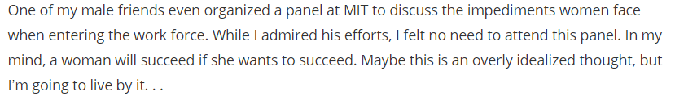
Meritocracy
Advancement and employability equal across individuals
Assumes no systemic barriers which advantage certain groups
  Undermines support for equality interventions
  Success is based on personal choices
(Bird & Rhoton, 2021; Seron et al., 2018)

Slide 5
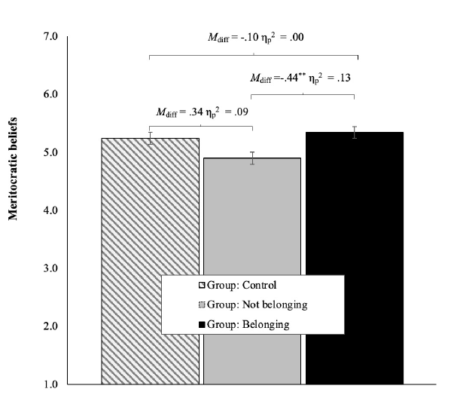
Meritocracy
Greater belonging in STEM = higher meritocracy beliefs
(Fernandez et al., 2024)

Slide 6
Study 1
N = 138
  45.7% men
  90.6% White
  42% staff (lecturer, professor)
  35% postgraduate students (PhD)
  23% postdocs and research support staff
  Recruited from 3 UK universities
(Farrell, Petzel et al., 2021)

Slide 7
Study 1
Randomly assigned to view email from “anonymous” university
  New equality initiative being introduced
  Manipulated to emphasize:
    Meritocracy (benefits men & women)
    Affirmative action (benefits women)
Also measured:
  Support for intervention
  Internal motivations (more later…)
(Farrell, Petzel et al., 2021)

Slide 8
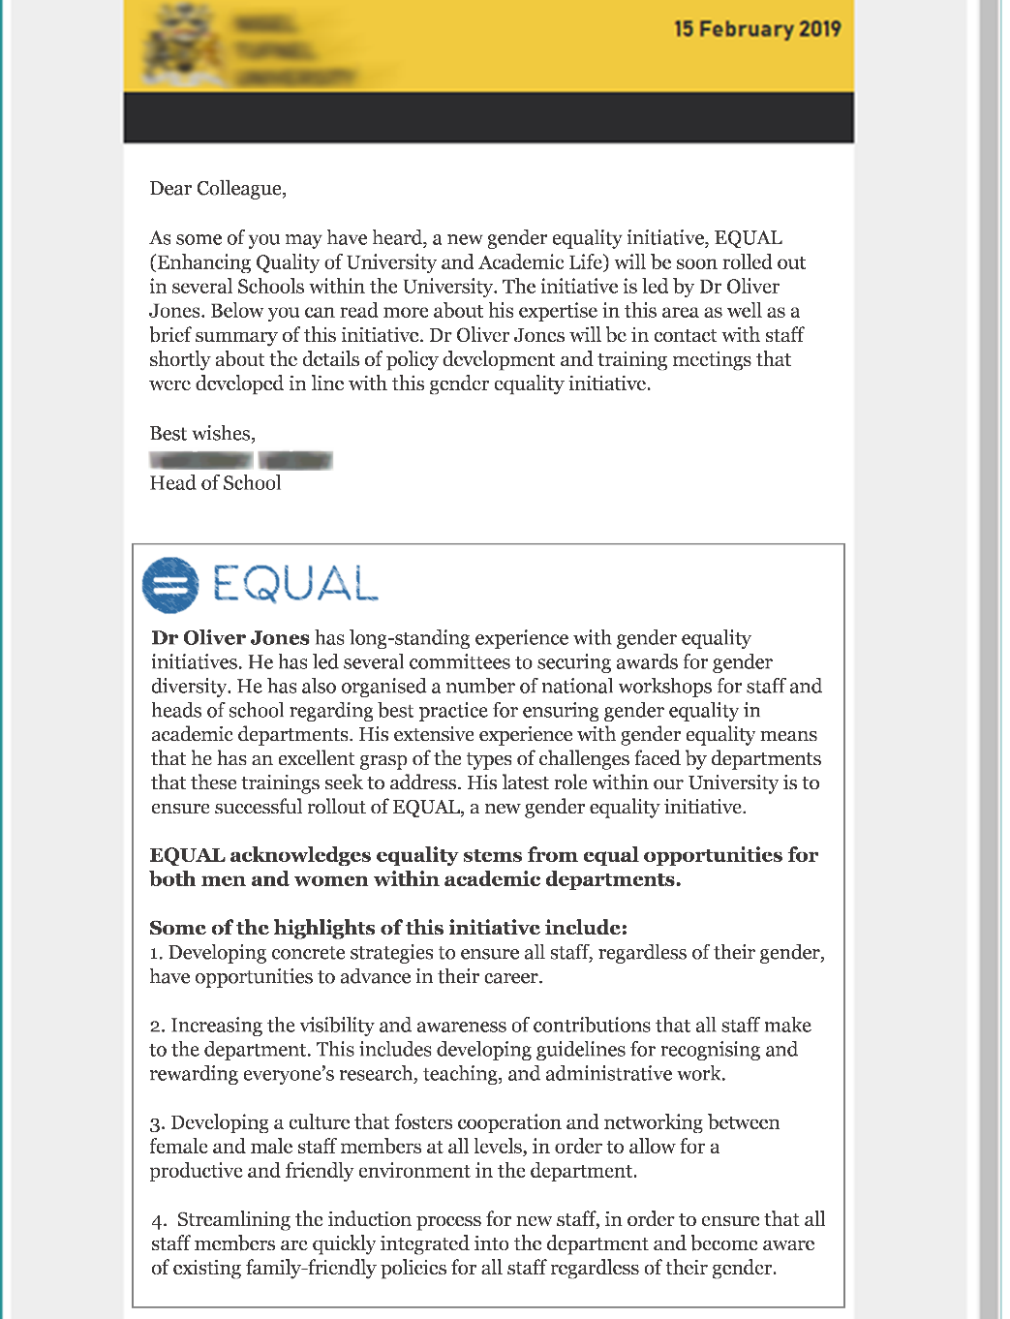
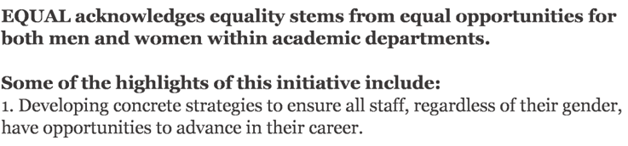
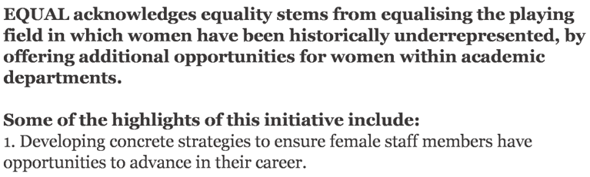
Study 1
Meritocracy
Affirmative action

Slide 9
Study 1
F(1,134) = 5.88, p = .017, η² = .042

Slide 10
Study 1
Interventions which emphasize meritocracy
  Increases support among men
  No difference among women
Interventions which emphasize affirmative action
  Decreases support among men
  May elicit backlash against interventions (Legault et al., 2011)
(Farrell, Petzel et al., 2021)

Slide 11
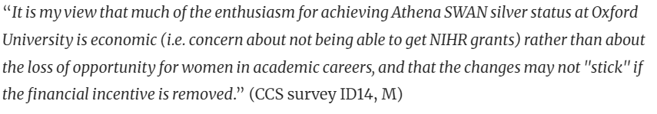
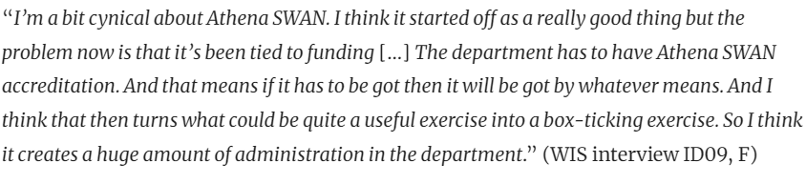
Roadblocks
Interventions often perceived as mandated or required
Participation is motivated by external incentives
(Ovseiko et al. 2017)

Slide 12
Self-determination theory
External/extrinsic motivations
  Behavior driven by rewards
  Rewards unrelated to behavior
Internal/intrinsic motivations
  Behavior driven by self-interest
  No explicit reward for behavior
  Behavior is rewarding in itself
(Ryan & Deci 2017)

Slide 13
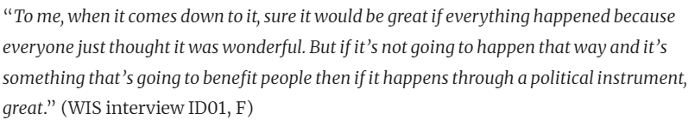
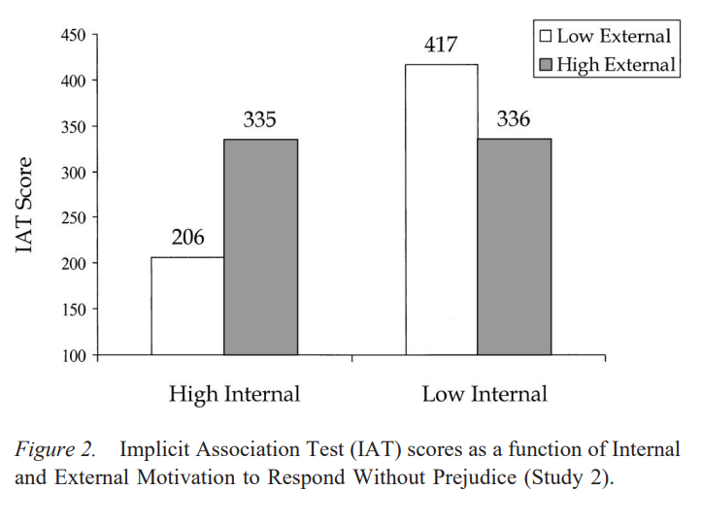
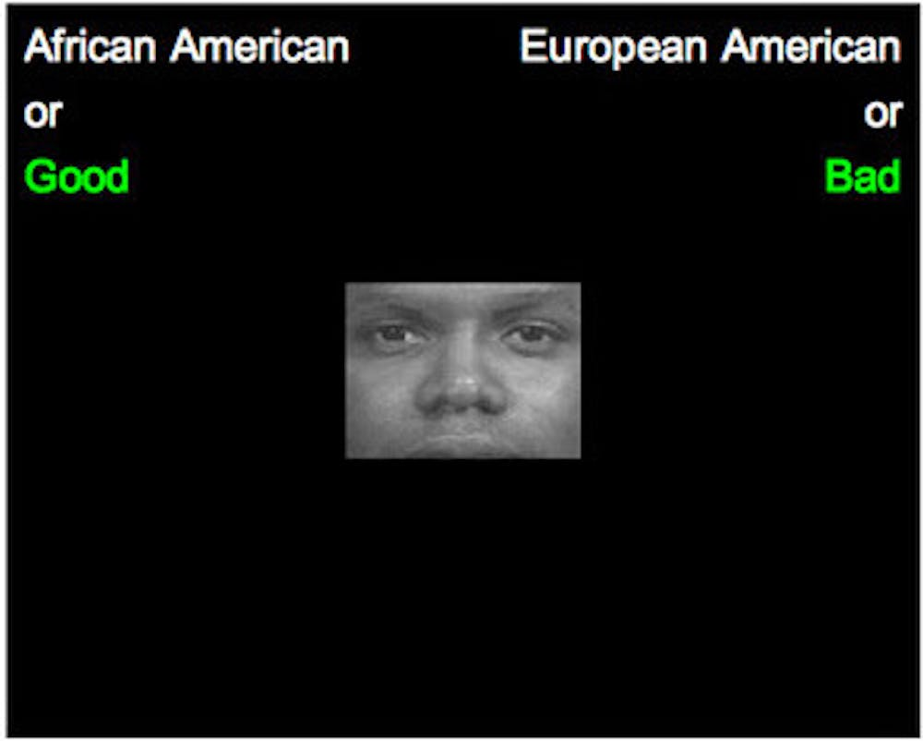
Self-determination theory
(Devine et al., 2002; Ovseiko et al. 2017)

Slide 14
Study 1
F(1,134) = 4.06, p = .046, η² = .031

Slide 15
Study 2
N = 137
  45.3% men
  89.1% White
  43% staff (lecturer, professor)
  38% postgraduate students (PhD)
  19% postdocs and research support staff
  Recruited from 3 UK universities
(Farrell, Petzel et al., 2021)

Slide 16
Study 2
Randomly assigned to view email from “anonymous” university
  New equality initiative being introduced
  Manipulated to emphasize:
    Mandatory participation (external motives)
    Optional participation (internal motives)
Also measured:
  Support for intervention
  Internal motivations
(Farrell, Petzel et al., 2021)

Slide 17
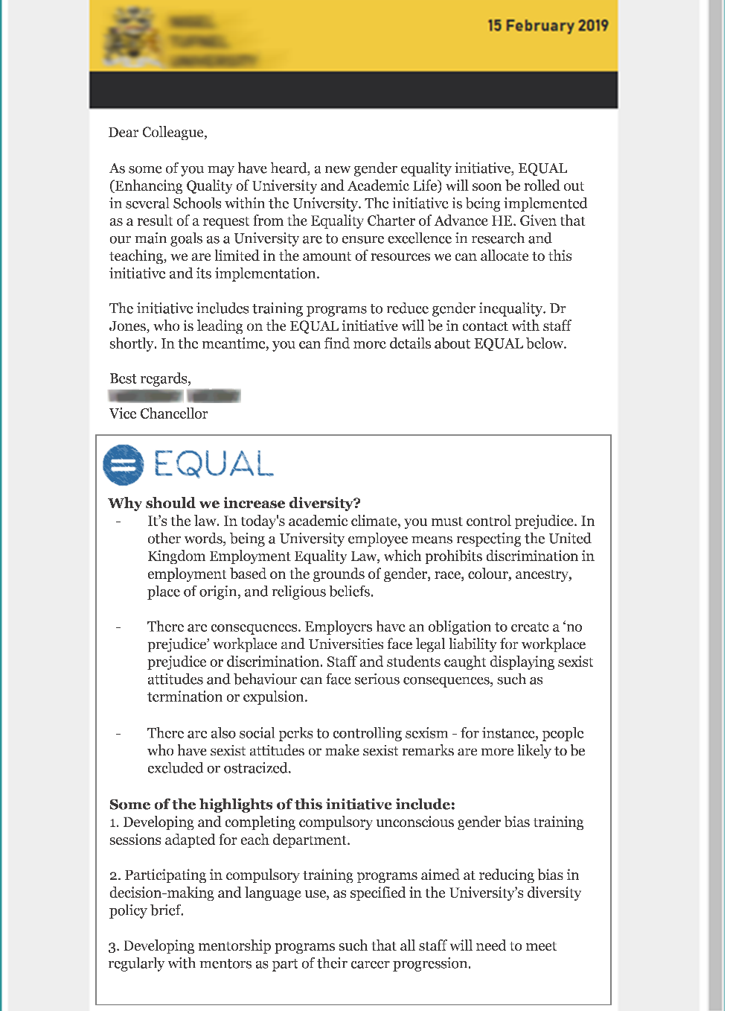
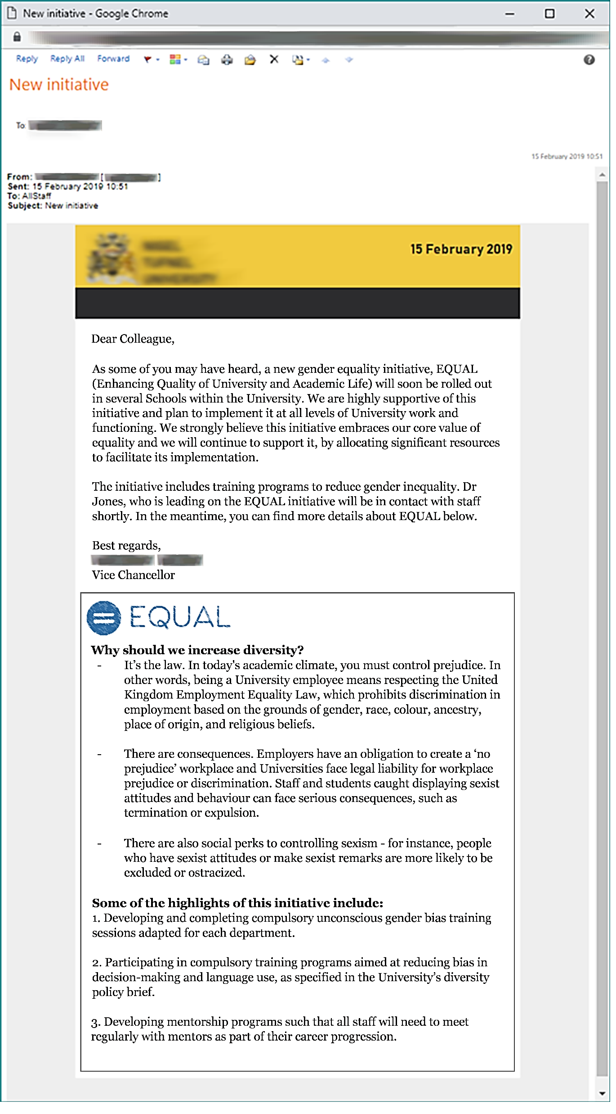

Study 2
External motives

Slide 18
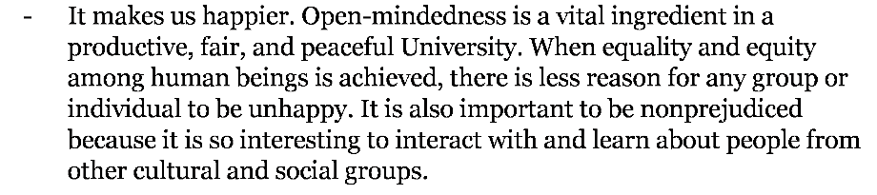
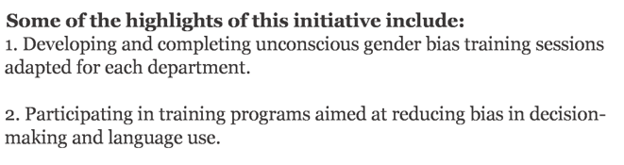
Study 2
Internal motives

Slide 19
Study 2
F(1,133) = 9.87, p < .001, η² = .099

Slide 20
Study 2
F(1,133) = 7.80, p = .006, η² = .055

Slide 21
Study 2
Interventions which are perceived as mandatory
  Reduce support among academics
  Undermine internal motivations
Interventions which foster internal motives
  Receive better support among academics
  Promote spontaneity of equality-focused actions
Effects may be stronger among men…
(Farrell, Petzel et al., 2021; Ryan & Deci 2017)

Slide 22
Discussion
Promoting engagement with interventions
  Highlight benefits for everyone, do not single out groups (Study 1)
  Avoid external motivators when promoting interventions (Study 2)
    Even those with internal motives may reduce engagement (Devine et al., 2002)
    Internal motivators promote spontaneity of actions (Ryan & Deci, 2017)
    External motivators may not generalize if reward removed (Ryan & Deci, 2017)
Women seem to support interventions regardless of…
  Meritocracy versus affirmative action
  External versus internal motivators

Slide 23
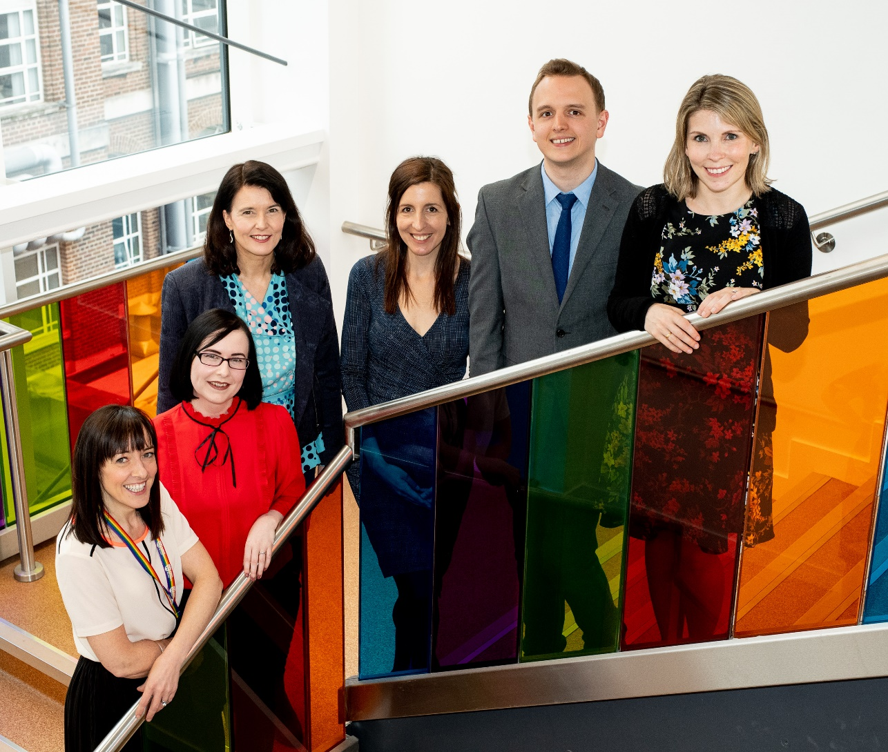


Thank you!
Queen’s University Belfast
Dr Ioana M Latu
Professor Rhiannon N Turner
Professor Teresa McCormack
Professor Karen Rafferty
National College of Ireland
Dr Lynn Farrell

